Slide 1
Ceacht 1
Ceacht 2
Ceacht 3
Ceacht 4
Ceacht 5
Notes:
Click on the lesson and it will bring you to the slides for that lesson. When you get to the ‘an Chríoch/That’s all folks’ slide that is the end of that lesson. If you click on the picture it will bring you back to this page.

Slide 2
Cén lá atá ann inniu?
Cén lá a bhí ann inné?
Cén lá a bheidh ann amárach?
An Luan | An Mháirt | An Chéadaoin | An Déardaoin | An Aoine | An Sathairn | An Domhnach

Slide 3
Ó

Slide 4
í

Slide 5
á

Slide 6
é

Slide 7
ú

Slide 8
mh

Slide 9
ch

Slide 10
th
Notes:
This is a new sound we are learning. The children have no heard this sound yet. This does not make the same sound as it does in English. The ‘t’ is silent.

Slide 11
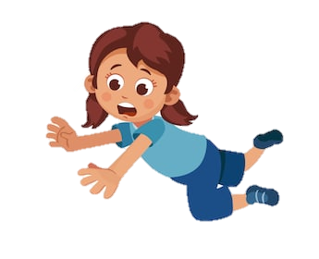
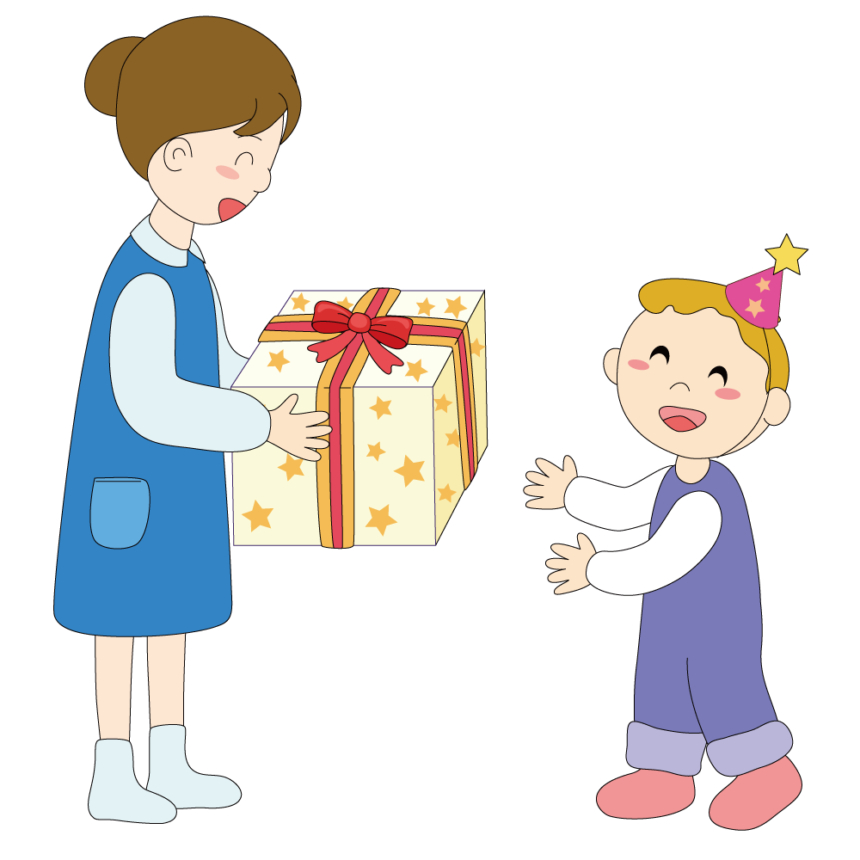
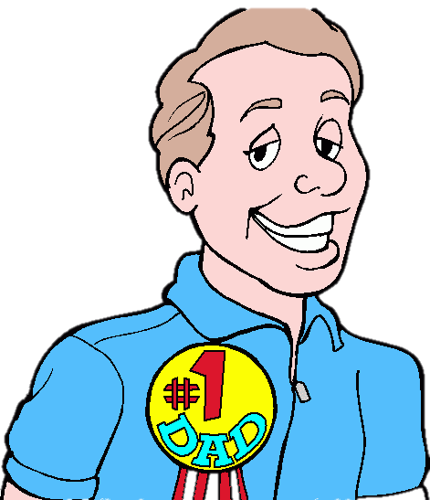
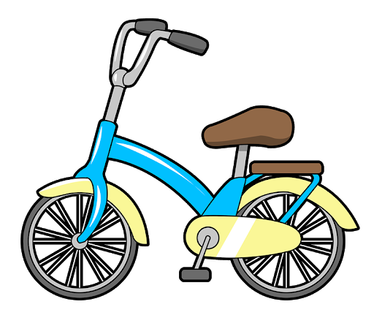
bláth
thit
bóthar
guth
thug
athair
dath
rothar
scáthán
Notes:
Practice the following words with your child every day. It is important that the see the letters ‘th’ as one sound and not 2 separate sounds.

Slide 13
Ubh chásca

Slide 23
Cluiche Kim
1. Dún do shúile.
Phrases to use for the game on the next slide.
Instructions in slide notes.
2. Oscail do shúile.
3. Cad atá imithe?
Notes:
This game is called cluiche kim. You can take turns with your child. Start by saying ‘Dún do shúile’ (Close your eyes). Then choose a picture and it will disappear. Then say ‘Oscail do shúile’ (Open your eyes) and ask ‘Cas atá imithe?’ (what is gone?). We play this game every day as it’s a fun way for the children to learn the words. After a couple of times playing this during the week the children should know all the words.

Slide 24
Notes:
This game is called cluiche kim. You can take turns with your child. Start by saying ‘Dún do shúile’ (Close your eyes). Then choose a picture and it will disappear. Then say ‘Oscail do shúile’ (Open your eyes) and ask ‘Cas atá imithe?’ (what is gone?). We play this game every day as it’s a fun way for the children to learn the words. After a couple of times playing this during the week the children should know all the words.

Slide 25
An Chríoch

Slide 26
Cén lá atá ann inniu?
Cén lá a bhí ann inné?
Cén lá a bheidh ann amárach?
An Luan | An Mháirt | An Chéadaoin | An Déardaoin | An Aoine | An Sathairn | An Domhnach

Slide 27
Ó

Slide 28
í

Slide 29
á

Slide 30
é

Slide 31
ú

Slide 32
mh

Slide 33
ch

Slide 34
th
Notes:
This is a new sound we are learning. The children have no heard this sound yet. This does not make the same sound as it does in English. The ‘t’ is silent.

Slide 35
bláth
thit
bóthar
guth
thug
athair
dath
rothar
scáthán
Notes:
Practice the following words with your child every day. It is important that the see the letters ‘th’ as one sound and not 2 separate sounds.

Slide 37
Ubh chásca

Slide 47
Cluiche Kim
1. Dún do shúile.
Phrases to use for the game on the next slide.
Instructions in slide notes.
2. Oscail do shúile.
3. Cad atá imithe?
Notes:
This game is called cluiche kim. You can take turns with your child. Start by saying ‘Dún do shúile’ (Close your eyes). Then choose a picture and it will disappear. Then say ‘Oscail do shúile’ (Open your eyes) and ask ‘Cas atá imithe?’ (what is gone?). We play this game every day as it’s a fun way for the children to learn the words. After a couple of times playing this during the week the children should know all the words.

Slide 48
Notes:
This game is called cluiche kim. You can take turns with your child. Start by saying ‘Dún do shúile’ (Close your eyes). Then choose a picture and it will disappear. Then say ‘Oscail do shúile’ (Open your eyes) and ask ‘Cas atá imithe?’ (what is gone?). We play this game every day as it’s a fun way for the children to learn the words. After a couple of times playing this during the week the children should know all the words.

Slide 49
Notes:
Game: Click on the sound and listen. Click the correct picture.

Slide 50
Ceart

Slide 51
Mícheart

Slide 53
Ceart

Slide 54
Mícheart

Slide 56
Ceart

Slide 57
Mícheart

Slide 59
Ceart

Slide 60
Mícheart

Slide 62
Ceart

Slide 63
Mícheart

Slide 65
Ceart

Slide 66
Mícheart

Slide 68
Ceart

Slide 69
Mícheart

Slide 71
Ceart

Slide 72
Mícheart

Slide 74
Ceart

Slide 75
Mícheart

Slide 76
An Chríoch

Slide 77
Cén lá atá ann inniu?
Cén lá a bhí ann inné?
Cén lá a bheidh ann amárach?
An Luan | An Mháirt | An Chéadaoin | An Déardaoin | An Aoine | An Sathairn | An Domhnach

Slide 78
Ó

Slide 79
í

Slide 80
á

Slide 81
é

Slide 82
ú

Slide 83
mh

Slide 84
ch

Slide 85
th
Notes:
This is a new sound we are learning. The children have no heard this sound yet. This does not make the same sound as it does in English. The ‘t’ is silent.

Slide 86
bláth
thit
bóthar
guth
thug
athair
dath
rothar
scáthán
Notes:
Practice the following words with your child every day. It is important that the see the letters ‘th’ as one sound and not 2 separate sounds.

Slide 88
Ubh chásca

Slide 98
Cluiche Kim
1. Dún do shúile.
Phrases to use for the game on the next slide.
Instructions in slide notes.
2. Oscail do shúile.
3. Cad atá imithe?
Notes:
This game is called cluiche kim. You can take turns with your child. Start by saying ‘Dún do shúile’ (Close your eyes). Then choose a picture and it will disappear. Then say ‘Oscail do shúile’ (Open your eyes) and ask ‘Cas atá imithe?’ (what is gone?). We play this game every day as it’s a fun way for the children to learn the words. After a couple of times playing this during the week the children should know all the words.

Slide 99
Notes:
This game is called cluiche kim. You can take turns with your child. Start by saying ‘Dún do shúile’ (Close your eyes). Then choose a picture and it will disappear. Then say ‘Oscail do shúile’ (Open your eyes) and ask ‘Cas atá imithe?’ (what is gone?). We play this game every day as it’s a fun way for the children to learn the words. After a couple of times playing this during the week the children should know all the words.

Slide 100
Crann
An bhfuil ____ sa phictiúr.
buachaill
Coinín
Ciseán
Cat
Ubh Cásca
Tá ___ sa phictiúr.
Cailín
sicín
madra
Níl ____ sa phictiúr.
bláthanna
seacláid
Bláthanna
Scríobh 5 abairt.
Notes:
Ask ‘An bfuil _____ sa phictiúr?’. Use a mixture of things that are in the picture and things that aren’t (e.g. clog, mála scoile, cathaoir, teilifíseán)
Anwers:
Tá _____ sa phictiúr’ = There is ________ in the picture.
Níl ______ sa phictiúr. = There isn’t _________ in the picture.
The children can write down 5 sentences on their own when they are finished. Using the phrases in the green and red speech bubbles.

Slide 101
An Chríoch

Slide 102
Cén lá atá ann inniu?
Cén lá a bhí ann inné?
Cén lá a bheidh ann amárach?
An Luan | An Mháirt | An Chéadaoin | An Déardaoin | An Aoine | An Sathairn | An Domhnach

Slide 103
Ó

Slide 104
í

Slide 105
á

Slide 106
é

Slide 107
ú

Slide 108
mh

Slide 109
ch

Slide 110
th
Notes:
This is a new sound we are learning. The children have no heard this sound yet. This does not make the same sound as it does in English. The ‘t’ is silent.

Slide 111
bláth
thit
bóthar
guth
thug
athair
dath
rothar
scáthán
Notes:
Practice the following words with your child every day. It is important that the see the letters ‘th’ as one sound and not 2 separate sounds.

Slide 113
Ubh chásca

Slide 123
Cluiche Kim
1. Dún do shúile.
Phrases to use for the game on the next slide.
Instructions in slide notes.
2. Oscail do shúile.
3. Cad atá imithe?
Notes:
This game is called cluiche kim. You can take turns with your child. Start by saying ‘Dún do shúile’ (Close your eyes). Then choose a picture and it will disappear. Then say ‘Oscail do shúile’ (Open your eyes) and ask ‘Cas atá imithe?’ (what is gone?). We play this game every day as it’s a fun way for the children to learn the words. After a couple of times playing this during the week the children should know all the words.

Slide 124
Notes:
This game is called cluiche kim. You can take turns with your child. Start by saying ‘Dún do shúile’ (Close your eyes). Then choose a picture and it will disappear. Then say ‘Oscail do shúile’ (Open your eyes) and ask ‘Cas atá imithe?’ (what is gone?). We play this game every day as it’s a fun way for the children to learn the words. After a couple of times playing this during the week the children should know all the words.

Slide 125
Fíor nó Bréagach
Léamh an abairt.
Pioc Fíor nó bréagach.
Instructions in English in slide notes.
Notes:
Read the sentence. Is it true or false?
Remember:
Fíor = true
Bréagach = false
Tá ___________ sa phictiúr = _____________ is in the picture.
Níl ___________ sa phictiúr. ______________ is not in the picture.

Slide 126
Tá coinín sa phictiúr.
Fíor
Bréagach

Slide 127
Ceart

Slide 128
Mícheart

Slide 129
Tá sicín sa phictiúr.
Fíor
Bréagach

Slide 130
Ceart

Slide 131
Mícheart

Slide 132
Níl buachaill sa phictiúr.
Fíor
Bréagach

Slide 133
Ceart

Slide 134
Mícheart

Slide 135
Níl mála scoile sa phictiúr.
Fíor
Bréagach

Slide 136
Ceart

Slide 137
Mícheart

Slide 138
Tá clár bán sa phictiúr.
Fíor
Bréagach

Slide 139
Ceart

Slide 140
Mícheart

Slide 141
Tá teilifíseán sa phictiúr.
Fíor
Bréagach

Slide 142
Ceart

Slide 143
Mícheart

Slide 144
Tá bláthanna sa phictiúr.
Fíor
Bréagach

Slide 145
Ceart

Slide 146
Mícheart

Slide 147
Níl ubh chásca sa phictiúr.
Fíor
Bréagach

Slide 148
Ceart

Slide 149
Mícheart

Slide 150
Tá ubh chásca sa phictiúr.
Fíor
Bréagach

Slide 151
Ceart

Slide 152
Mícheart

Slide 153
Tá seacláid sa phictiúr.
Fíor
Bréagach

Slide 154
Ceart

Slide 155
Mícheart

Slide 156
An Chríoch

Slide 157
Cén lá atá ann inniu?
Cén lá a bhí ann inné?
Cén lá a bheidh ann amárach?
An Luan | An Mháirt | An Chéadaoin | An Déardaoin | An Aoine | An Sathairn | An Domhnach

Slide 158
Ó

Slide 159
í

Slide 160
á

Slide 161
é

Slide 162
ú

Slide 163
mh

Slide 164
ch

Slide 165
th
Notes:
This is a new sound we are learning. The children have no heard this sound yet. This does not make the same sound as it does in English. The ‘t’ is silent.

Slide 166
bláth
thit
bóthar
guth
thug
athair
dath
rothar
scáthán
Notes:
Practice the following words with your child every day. It is important that the see the letters ‘th’ as one sound and not 2 separate sounds.

Slide 167
Deachtú
Test yourself!
See how many words you can spell correctly from the previous slide.
Don’t forget ‘th’.

Slide 169
Ubh chásca

Slide 179
Cluiche Kim
1. Dún do shúile.
Phrases to use for the game on the next slide.
Instructions in slide notes.
2. Oscail do shúile.
3. Cad atá imithe?
Notes:
This game is called cluiche kim. You can take turns with your child. Start by saying ‘Dún do shúile’ (Close your eyes). Then choose a picture and it will disappear. Then say ‘Oscail do shúile’ (Open your eyes) and ask ‘Cas atá imithe?’ (what is gone?). We play this game every day as it’s a fun way for the children to learn the words. After a couple of times playing this during the week the children should know all the words.

Slide 180
Notes:
This game is called cluiche kim. You can take turns with your child. Start by saying ‘Dún do shúile’ (Close your eyes). Then choose a picture and it will disappear. Then say ‘Oscail do shúile’ (Open your eyes) and ask ‘Cas atá imithe?’ (what is gone?). We play this game every day as it’s a fun way for the children to learn the words. After a couple of times playing this during the week the children should know all the words.

Slide 181
Do _________.
Cáisc shona duit.
Ó __________.
Notes:
Make a card. Print the page and colour it or make your own card, decorate it and write in Irish inside it.

Slide 182
An Chríoch

